Slide 1

Notes:
http://coenraets.org/present/react/#3
http://slides.com/alexanderfarennikov/react-js-fundamentals/fullscreen#/20
https://scotch.io/tutorials/learning-react-getting-started-and-concepts

Slide 2
Startingpoint
Clone:
https://github.com/petereijgermans11/workshop-reactjs-angular

Slide 3
What?
React is a library for building composable user interfaces

Slide 4
Why?
Have the ability to split UI in components
DOM is slow, React makes this faster
Notes:
https://facebook.github.io/react/blog/2013/06/05/why-react.html

Slide 5
Features
Virtual DOM
One-way data flow
JSX
React-native

Slide 6
History
Created in 2011 by Jordon Walke
At Facebook
Opensource in 2013
2015 React-native created

Slide 7
Syntax Component
Class Welcome extends React.Component{
render() {
return <div>Hello {this.props.name}</div>; → JSX
}
}
// Welcome name="Sara" />
Notes:
You can embed any JavaScript expression in JSX by wrapping it in curly braces.
Conceptually, components are like JavaScript functions. They accept arbitrary inputs (called "props") and return React elements describing what should appear on the screen.
Always start component names with a capital letter.
For example, <div /> represents a DOM tag, but <Welcome /> represents a component and requires Welcome to be in scope.

Slide 8
React.createElement()
Babel compiles JSX down to React.createElement() calls:
return React.createElement('div', Hello {this.props.name });
Notes:
These objects are called "React elements". You can think of them as descriptions of what you want to see on the screen. React reads these objects and uses them to construct the DOM and keep it up to date.

Slide 9
How can this be?
You are able to use JSX when using a transpiler like Babel.

Slide 10
JSX
Since JSX is closer to JavaScript than HTML, React DOM uses camelCase property naming convention instead of HTML attribute names. (onClick, className, style, etc)

Slide 11
Component: class
2 types of state:
this.props
Get properties from parent
this.state
Local state within components

Slide 12
export class Welcome extends React.Component {
render() {
return <h1>Hello, {this.props.name}</h1>;
}
}
class App extends React.Component {
render() {
return (
<div>
<Welcome name="Sara" />
<Welcome name="Cahal" />
<Welcome name="Edite" />
</div>
);
}
}
ReactDOM.render(
<App />, document.getElementById('root')
);
Notes:
Export?

Slide 13
this.props
Never ever changes props!
This is the responsibility for the parent
and not the child

Slide 14
Component based
Index.html
props
AppComponent
props
props
props
BookSearchComponent
DashBoardComponent
BooksComponent
props
props
BookDetalsComponent

Slide 15
Component based
AppComponent
BookSearchComponent
DasboardComponent

Slide 16
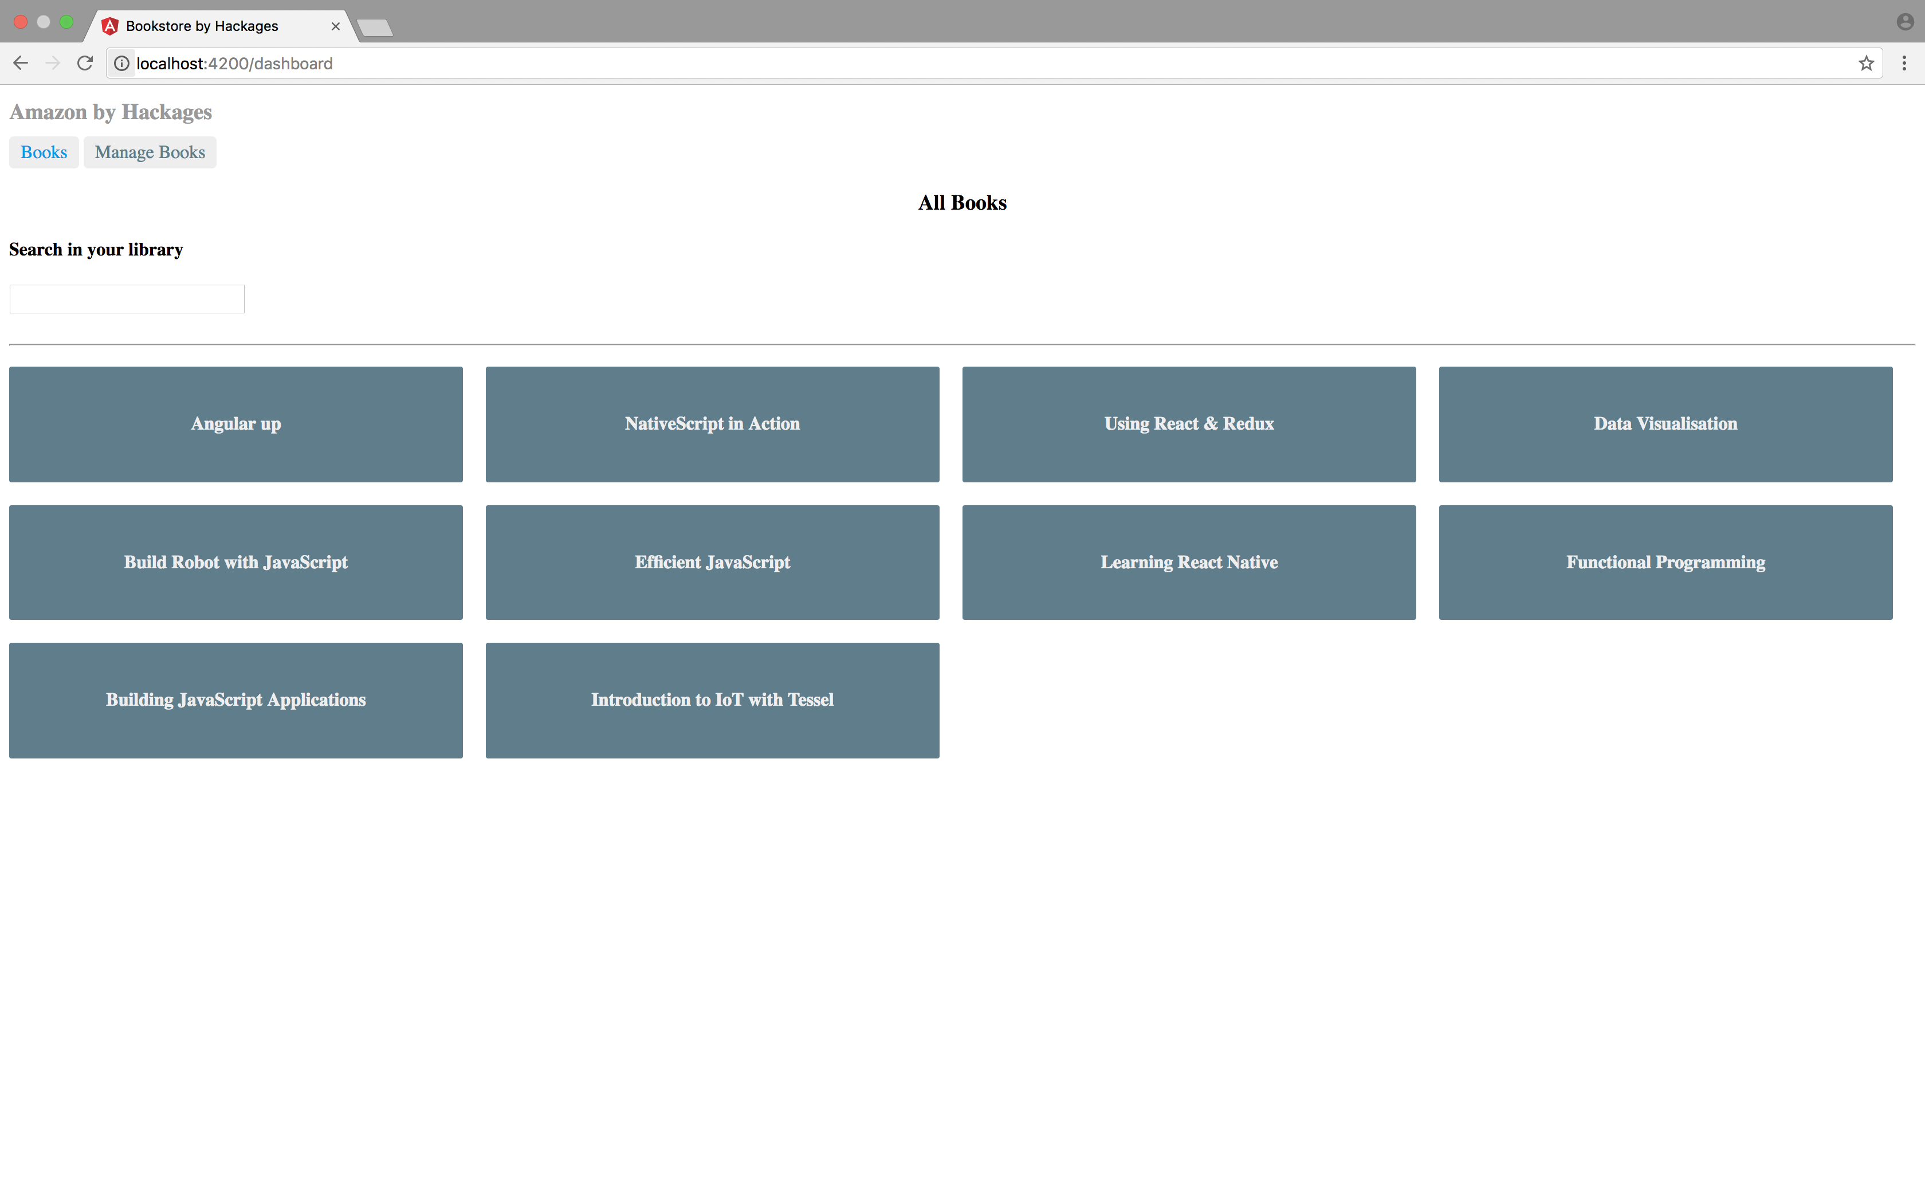
BookSearch and DashBoard

Slide 17
BookSearchComponent
export class BookSearch extends React.Component {
constructor(props){
super(props);
this.state = {
books: [],
}
}
search = (event) => {
axios.get("http://localhost:5000/books/?q=" + event.target.value).then((response) => {
this.setState({
books: response.data
})
});
};
Notes:
Set State!
Use AXIOS: Promise based HTTP client for node.js
Use ES6 arrow functions
An arrow function expression has a shorter syntax than a function expression and does not bind its own this.
You can program in an object oriented OR functional way with Arrow functions.

Slide 18
this.setState()
Do not! Change state with this.state = newState.
Use this.setState( )
Otherwise react will not re-render, and possibly overwrite your state.

Slide 19
DashBoardComponent
export class Dashboard extends React.Component {
constructor(props) {
super(props);
this.state = {
books: [‘book1’,’book2’]
}
}
componentDidMount(){
// You should fetch de books from http://localhost:5000/books
// and store them in your state
}
render() {
return (
<div>
<h3>All Books</h3>
<BookSearch />
{this.state.books.map(book => (
<h4>{book}</h4>
))}
</div>
);
}
}
Notes:
Use ES6 arrow functions
An arrow function expression has a shorter syntax than a function expression and does not bind its own this.
You can program in an object oriented OR functional way with Arrow functions.

Slide 20
DashBoardComponent
export class Dashboard extends React.Component {
constructor(props) {
super(props);
this.state = {
books: [ ]
}
}
componentDidMount() {
axios.get("http://localhost:5000/books").then((response) => {
this.setState({
books: response.data
})
});
}
render() {
return (
<div>
<h3>All Books</h3>
<BookSearch />
{this.state.books.map(book => (
<h4>{book.title}</h4>
))}
</div>
);
}
}
Notes:
Zie data.json voor de test data!
Use ES6 arrow functions!

Slide 21
Template literals
var url = 'http://localhost:3000/api/messages/' + id
var url = `http://localhost:3000/api/messages/${id}`

Slide 22
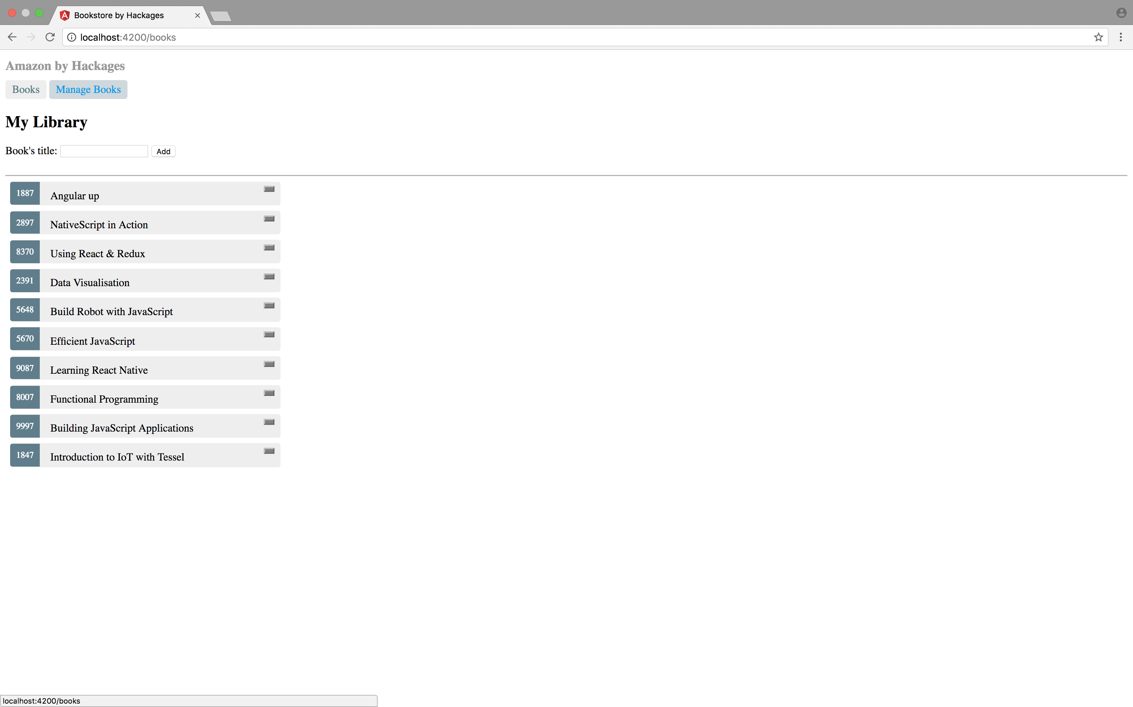
BooksComponent

Slide 23
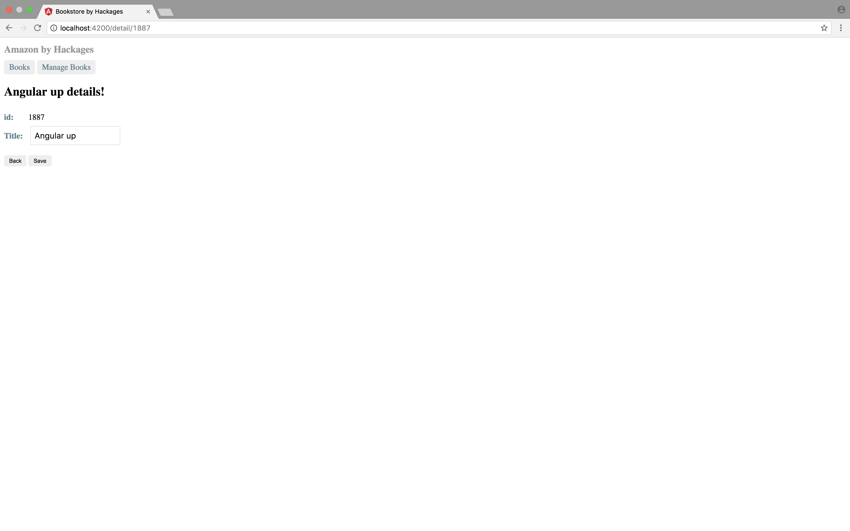
BookDetailComponent

Slide 24
BookDetailComponent
export class BookDetail extends React.Component {
constructor(props) {
}
componentDidMount(){
this.fetchBook(this.props.match.params.id);
}
----
App.js
<Route path="/detail/:id" component={BookDetail} />
Notes:
componentDidMount(){
this.fetchBook(this.props.match.params.id); →
}
https://medium.com/@pshrmn/a-simple-react-router-v4-tutorial-7f23ff27adf
The :number part of the path /roster/:number means that the part of the pathname that comes after /roster/ will be captured and stored as match.params.number. For example, the pathname /roster/6 will generate a params object :
{ number: '6' } // note that the captured value is a string

Slide 25
Component: lifecycles
Mounting
Updating
Unmounting
Notes:
https://facebook.github.io/react/docs/react-component.html

Slide 26
Component: lifecycles
Mounting:
constructor()
componentWillMount()
render()
componentDidMount()
Notes:
https://facebook.github.io/react/docs/react-component.html

Slide 27
Component: lifecycles
Updating:
componentWillReceiveProps()
shouldComponentUpdate()
componentWillUpdate()
render()
componentDidUpdate()
Notes:
https://facebook.github.io/react/docs/react-component.html

Slide 28
Component: lifecycles
Unmounting:
componentWillUnmount()
Notes:
https://facebook.github.io/react/docs/react-component.html

Slide 29
Example
class Title extends Component { componentWillMount() { console.log("I'm mounting now!") } render() { return <h1>{this.props.testing}{this.props.children}</h1> } }

Slide 30
Additional information
https://facebook.github.io/react/docs/hello-world.html
https://github.com/airbnb/javascript/tree/master/react

